Slide 1

“Hilbert huang Transform and implementation to plot a HHt spectra for a typical time series”
SIDDAGANGA INSTITUTE OF TECHNOLOGY
Dept. of Information Science and Engineering
BY: Devesh Charan 1SI14IS017

Slide 2
Content
INTRODUCTION
LITERATURE SURVEY
ALGORITHM
APPLICATION
LIMITATIONS
CONCLUSION
BIBLIOGRAPHY

Slide 3
INTRODUCTION
Developed in 1998
Norden E. Huang, Scientist at NASA
Data Everywhere
Data Analysis Tool
Substitute of Fourier Transform
Used for Non linear and Non Stationary Signals

Slide 4




LITERATURE SURVEY
The HHT technique for analysing data consists of two components: a decomposition algorithm called empirical mode decomposition (EMD) and a spectral analysis tool called Hilbert spectral analysis.
The purpose of HHT is to demonstrate an alternative method to present spectral analysis tools for providing the time-frequency-energy description of time series data
Sum of all amplitude or energy is

Slide 5
LITERATURE SURVEY
The EMD algorithm is the other component to the HHT method. The algorithm attempts to decompose nearly any signal into a finite set of functions, whose Hilbert transforms give physical instantaneous frequency values.
These functions are called intrinsic mode functions (IMFs).
The algorithm utilizes an iterative sifting process which successively subtracts the local mean from a signal.
The sifting process is repeated until the signal meets the definition of an IMF.

Slide 6
ALGORITHM
The sifting process is as follows:
Determine the local extrema (maxima, minima) of the signal.
Connect the maxima with an interpolation function, creating an upper envelope about the signal.
Connect the minima with an interpolation function, creating a lower envelope about the signal.
Calculate the local mean as half the difference between the upper and lower envelopes.
Subtract the local mean from the signal.
Iterate on the residual.

Slide 7
Algorithm
An oscillating wave is defined as Implicit Mode Function (IMF) if it satisfies two conditions:
the number of extrema and the number of zero crossing differs only by one and
the local average is zero. The condition that the local average is zero implies that envelop mean of upper envelop and lower envelop is zero.

Slide 8
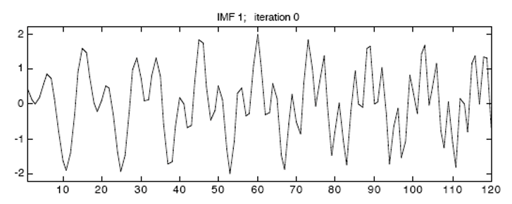
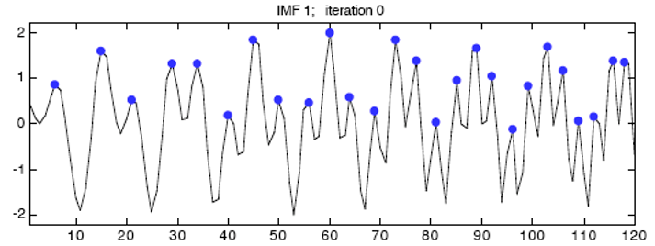
algorithm

Slide 9
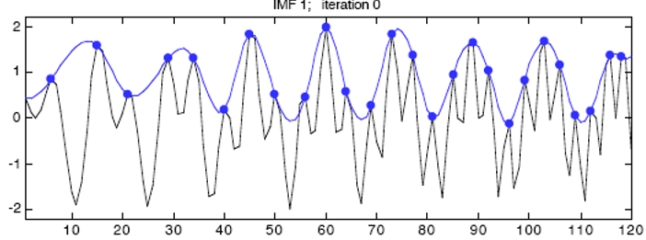
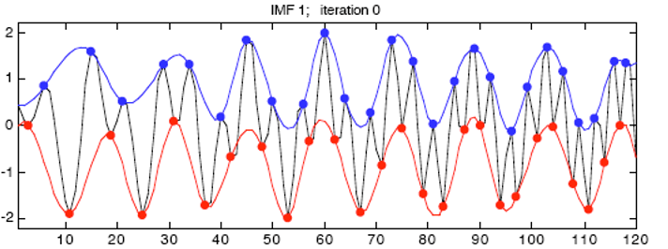
algorithm

Slide 10
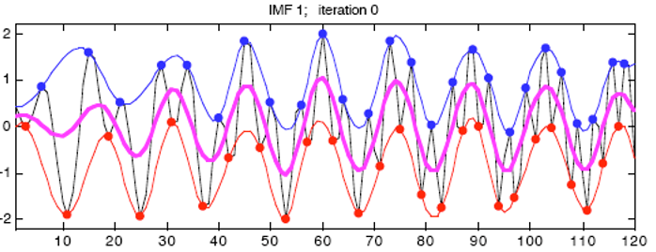
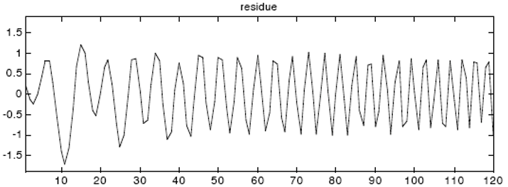
algorithm

Slide 11
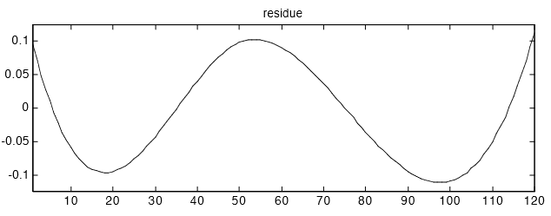
algorithm

Slide 12
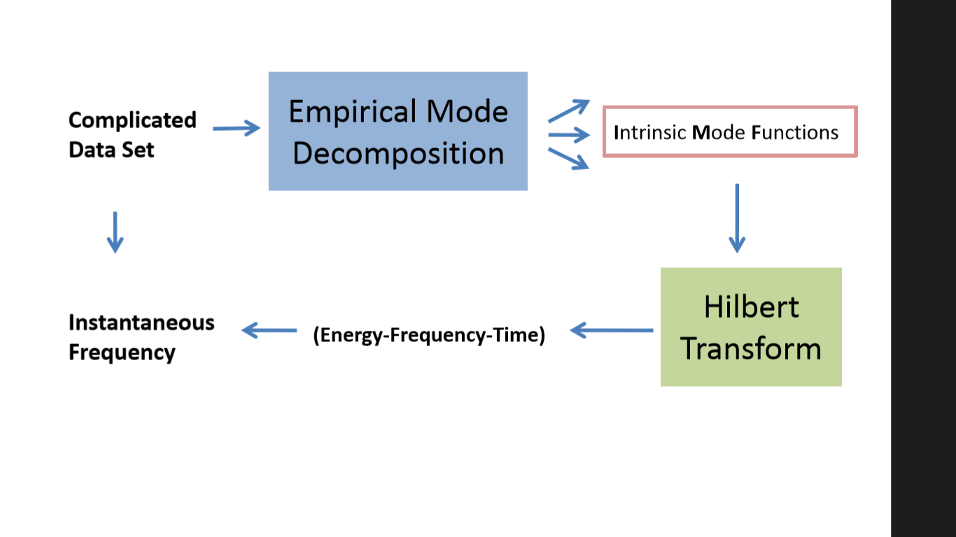
FlowCharat

Slide 13
Application
Used for studying the global surface temperature.
Analysis of sunspot variability
EMD has also been applied to study the concentration of carbon dioxide
Analysis of Rainfall data

Slide 14
CONCLUSION
The combination of the empirical mode decomposition (EMD) method and the associated Hilbert spectral analysis has oﬀered a powerful method for nonlinear non-stationary data analysis
A great advantage of EMD and Hilbert spectral analysis is the eﬀective use of the data.
By adopting the instantaneous frequency, we have not only eliminated the need for higher harmonics to simulate the nonlinearly deformed waves, but also the spurious harmonics to simulate the non-stationary data

Slide 15
BIBLIOGRAPHY
PAPERS
The empirical mode decomposition and the Hilbert spectrum for nonlinear and non-stationary time series analysis, By Norden E. Huang1, Zheng Shen2, Steven R. Long3, Manli C. W u4, Hsing H. Shih5, Quanan Zheng6, Nai-Chyuan Yen7, Chi Chao Tung8 and Henry H. Liu9,The Royal Society
The Hilbert-Huang Transform: theory, applications, development Bradley Lee Barnhart University of Iowa
WEBSITES
http://rcada.ncu.edu.tw/research1.htm

Slide 16


